Slide 1
USING MACHINE LEARNING TO SUGGEST FOOD, COFFEE, NIGHTLIFE, FUN AND SHOPPING PLACES TO TOURISTS
Abhishek paul
National institute of technology, Durgapur

Slide 2
Introduction
Business Problem:
The objective of this project is to suggest tourists visiting Kolkata, India places for food, coffee, nightlife, fun and shopping based on the location of the hotel in which they will be staying to save their time making plans. I have used an Unsupervised Machine Learning method, namely, Clustering for recommending the tourists places. This project aims to answer the question: What are the places for food, coffee, nightlife, fun and shopping that tourists can try out?

Slide 3
Background:
For this capstone project, I am concentrating on the scenario of tourists visiting Kolkata, India. Kolkata is called ‘the city of joy’. The city is known for its grand colonial architecture, art galleries, cultural festivals, sweets, food culture and many more. Kolkata is a common destination for vacations. This city attracts tourists from all over the world. So, this project is concerned about suggesting tourists places where they can hangout such as places for food, coffee, nightlife, fun and shopping and thereby saving their valuable vacation-time. This project takes into account the geocoordinates (latitude, longitude) of the hotel and based on the same, makes the suggestions.
Target Audience:
The target audience for this project are the tourists visiting spending their vacation in Kolkata, IN.

Slide 4
Clustering:
Clustering is the task of dividing the population or data points into a number of groups such that data points in the same groups are more similar to other data points in the same group and dissimilar to the data points in other groups. The particular method used in the project is k-means clustering. The procedure follows a simple and easy way to classify a given data set through a certain number of clusters (assume k clusters) fixed apriori. The main idea is to define k centers, one for each cluster. The next step is to take each point belonging to a given data set and associate it to the nearest center. When no point is pending, the first step is completed. At this point we need to re-calculate k new centroids as barycentre of the clusters resulting from the previous step. After we have these k new centroids, a new binding has to be done between the same data set points and the nearest new center. A loop has been generated. As a result of this loop we may notice that the k centers change their location step by step until no more changes are done or in other words centers do not move any more.

Slide 5
Data
All the data used in the project are fetched using the FOURSQUARE API.
Data for hotels:
'https://api.foursquare.com/v2/venues/search?client_id={}&client_secret={}&ll={},{}&v={}&query={}&radius={}&limit={}'.format(CLIENT_ID, CLIENT_SECRET, Latitude, Longitude, VERSION, ‘Hotel’, RADIUS, LIMIT)
Data for food places near the hotel:
'https://api.foursquare.com/v2/venues/search?client_id={}&client_secret={}&ll={},{}&v={}&query={}&radius={}&limit={}'.format(CLIENT_ID, CLIENT_SECRET, HOTEL_Latitude, HOTEL_Longitude, VERSION, ‘Food’, RADIUS, LIMIT)

Slide 6
Data for coffee places near the hotel:
'https://api.foursquare.com/v2/venues/search?client_id={}&client_secret={}&ll={},{}&v={}&query={}&radius={}&limit={}'.format(CLIENT_ID, CLIENT_SECRET, HOTEL_Latitude, HOTEL_Longitude, VERSION, ‘Coffee’, RADIUS, LIMIT)
Data for nightlife places near the hotel:
'https://api.foursquare.com/v2/venues/search?client_id={}&client_secret={}&ll={},{}&v={}&query={}&radius={}&limit={}'.format(CLIENT_ID, CLIENT_SECRET, HOTEL_Latitude, HOTEL_Longitude, VERSION, ‘Nightlife’, RADIUS, LIMIT)

Slide 7
Data for fun places near the hotel:
'https://api.foursquare.com/v2/venues/search?client_id={}&client_secret={}&ll={},{}&v={}&query={}&radius={}&limit={}'.format(CLIENT_ID, CLIENT_SECRET, HOTEL_Latitude, HOTEL_Longitude, VERSION, ‘Fun’, RADIUS, LIMIT)
Data for shopping places near the hotel:
'https://api.foursquare.com/v2/venues/search?client_id={}&client_secret={}&ll={},{}&v={}&query={}&radius={}&limit={}'.format(CLIENT_ID, CLIENT_SECRET, HOTEL_Latitude, HOTEL_Longitude, VERSION, ‘Shopping’, RADIUS, LIMIT)

Slide 8
Methodology
The methodology used in this project is Unsupervised Machine Learning. I have used Clustering method for clustering the places for food, coffee, nightlife, fun and shopping. The particular method used here is K-Means Clustering. The main idea is to define k centers, one for each cluster. The next step is to take each point belonging to a given data set and associate it to the nearest center. When no point is pending, the first step is completed. At this point we need to re-calculate k new centroids as barycentre of the clusters resulting from the previous step. After we have these k new centroids, a new binding has to be done between the same data set points and the nearest new center. A loop has been generated. As a result of this loop we may notice that the k centers change their location step by step until no more changes are done or in other words centers do not move any more. I have clustered the places based on their geo-coordinates. Finally, I calculated the Euclidean distances of each cluster from the hotel and return the places belonging to the cluster that is the nearest to the hotel.

Slide 9
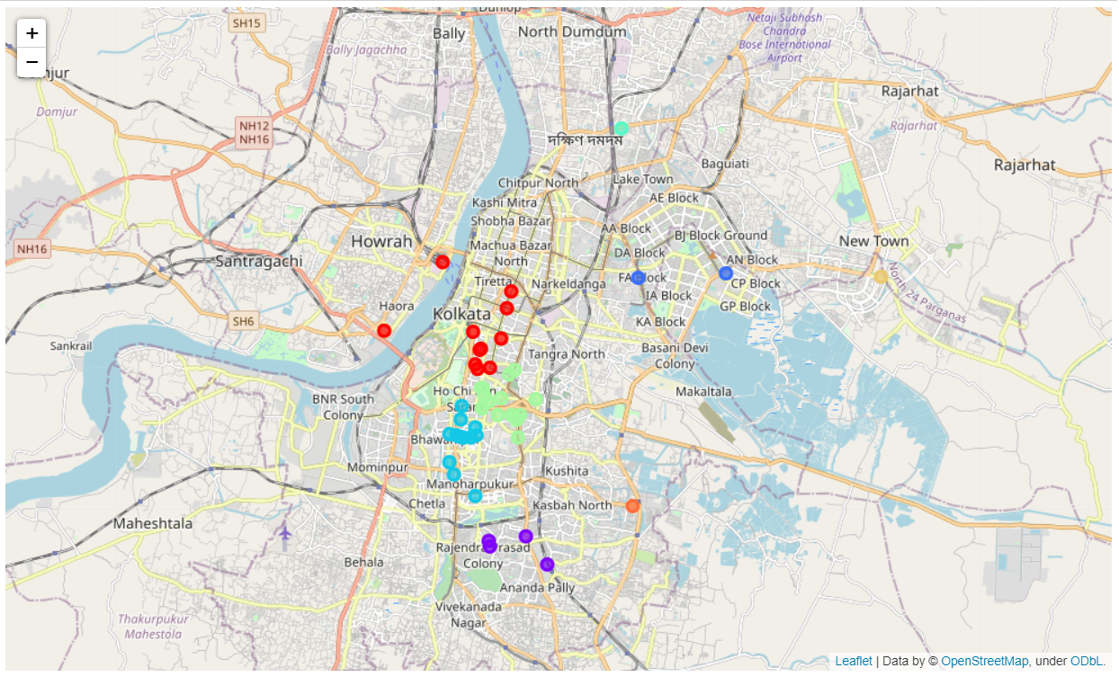
Results
The clustered places visualised on the folium map are as follows:
Places for food: (8 clusters)

Slide 10
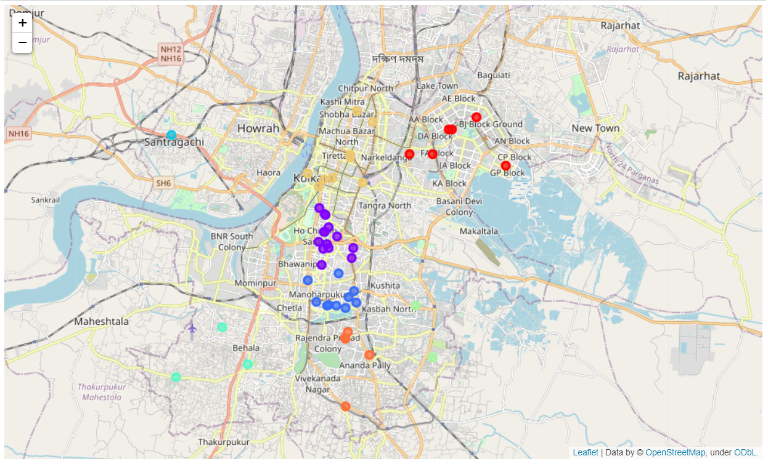
Places for coffee: (8 clusters)

Slide 11
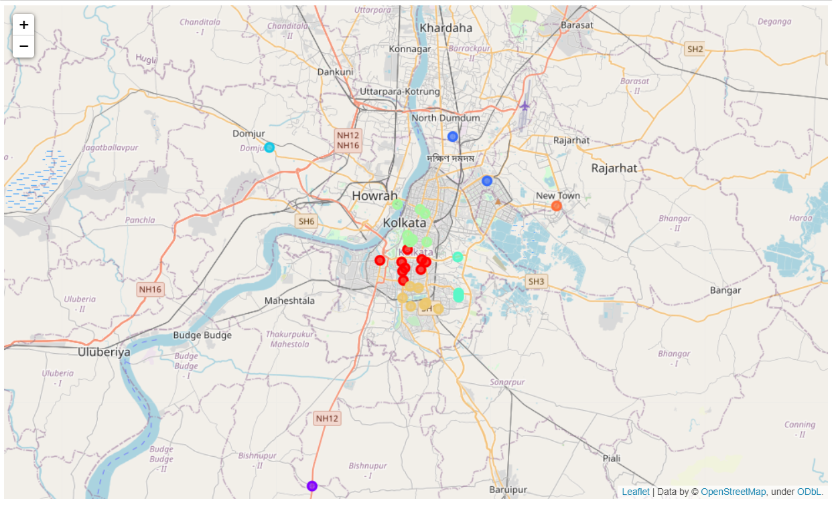
Places for nightlife: (8 clusters)

Slide 12
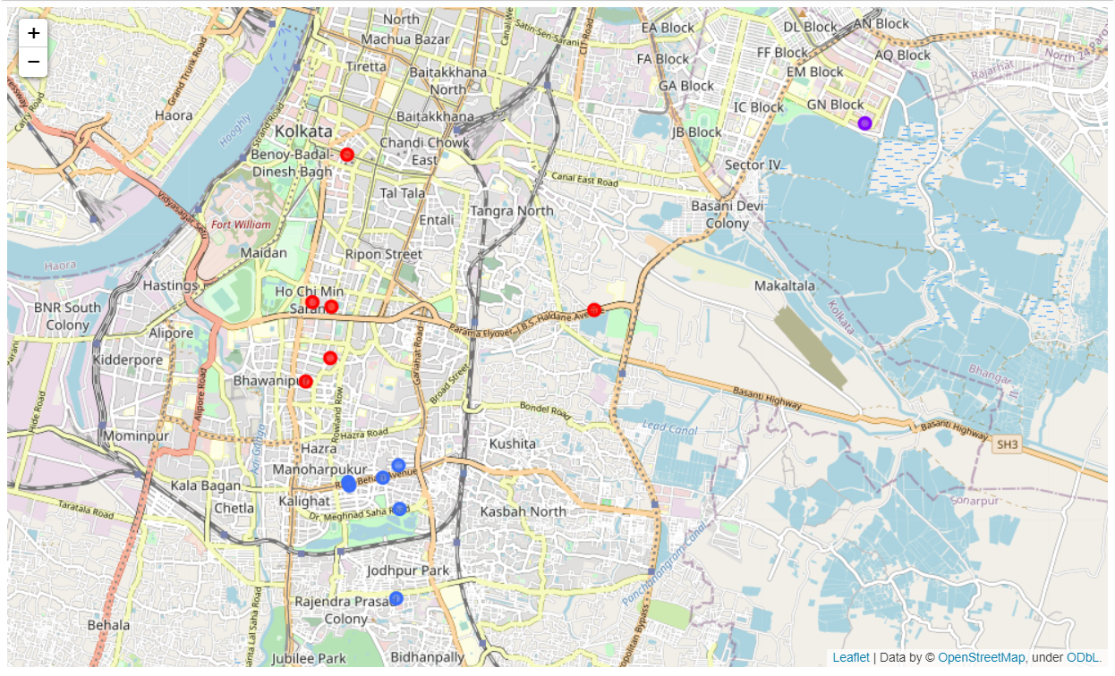
Places for fun: (3 clusters)

Slide 13
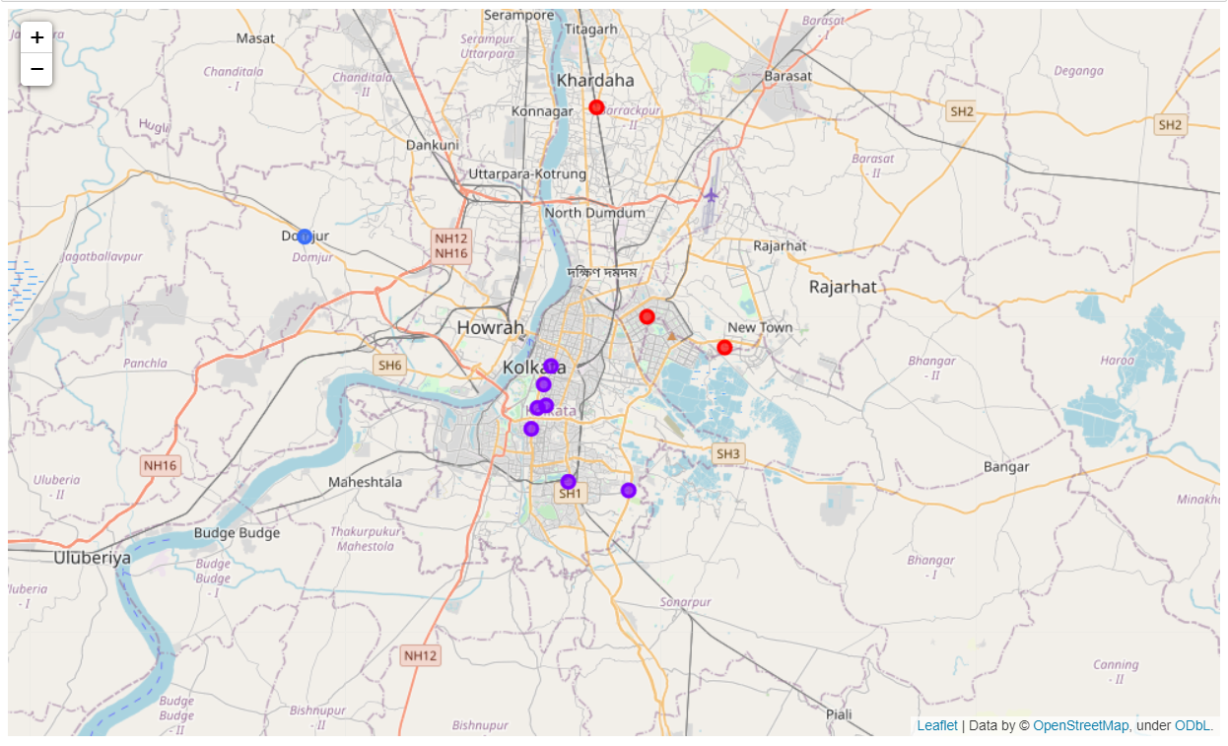
Places for shopping: (3 clusters)

Slide 14
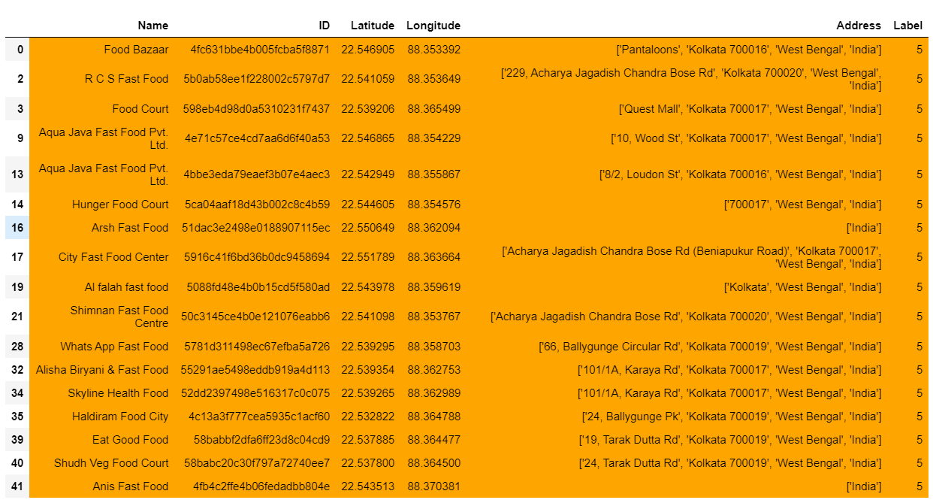
Suggested places for food:

Slide 15
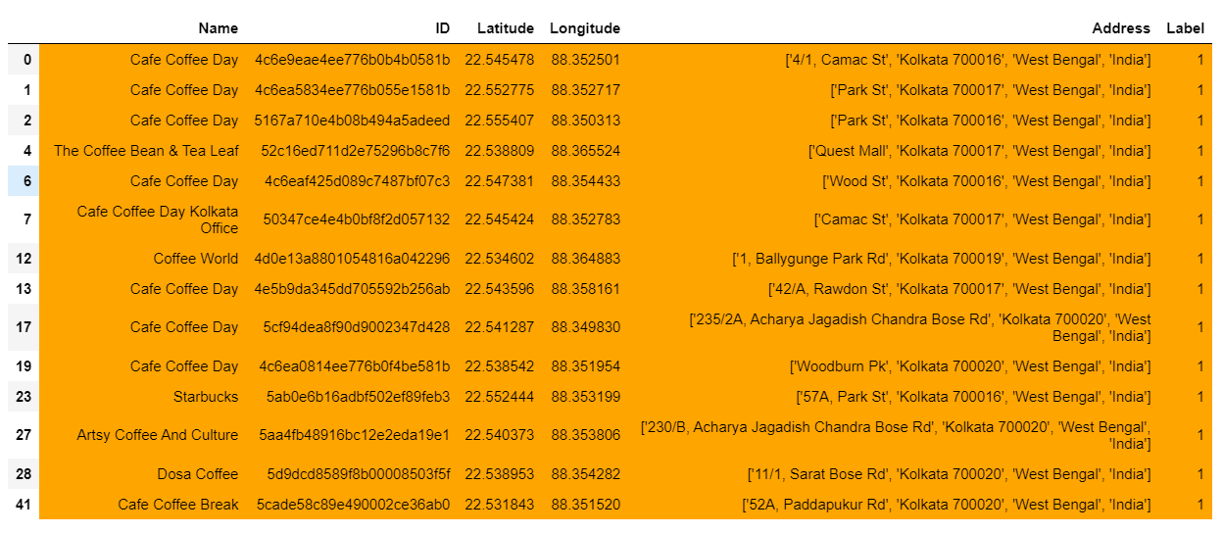
Suggested places for coffee:

Slide 16
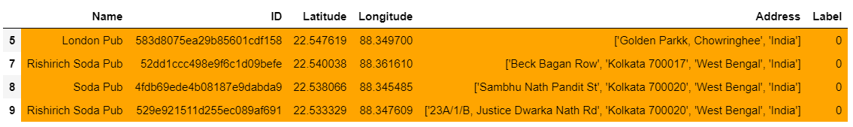
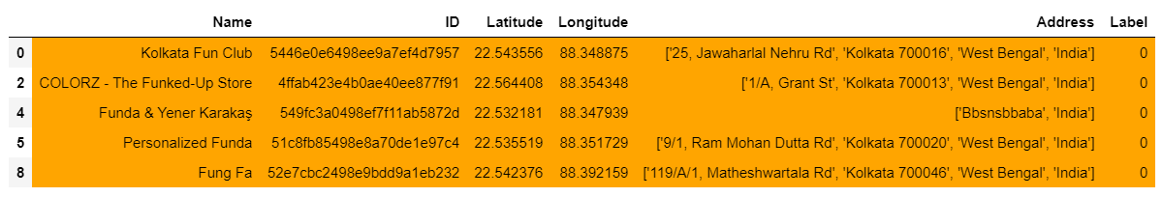
Suggested places for nightlife:
Suggested places for fun:

Slide 17
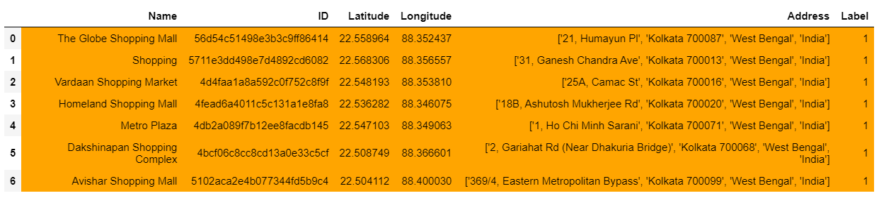
Suggested places for shopping:

Slide 18
discussion
The project did not take into account the details of the places as there were problems regarding Foursquare API calls, that could have contributed more to the legitimacy of the project.

Slide 19
Conclusion
The project took into consideration, that the tourist had put up in The Park Hotel, and then returned the suggest places for food, coffee, nightlife, fun and shopping that the tourist can try out.

